Slide 1
Final report
Team 1
Group 6

Slide 2

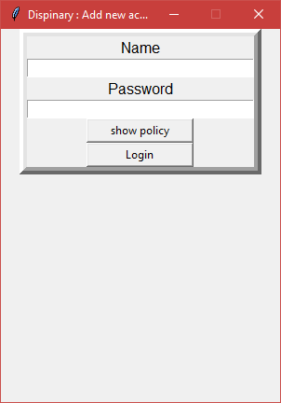
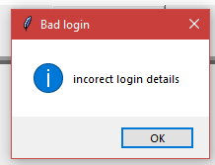
Program progress
Login screen
Will require a user’s first name and password
Will open the main disciplinary action screen if successfully logged in
Shows error message if incorrect name or password enter
Has a policy button to show the company’s policy

Slide 3
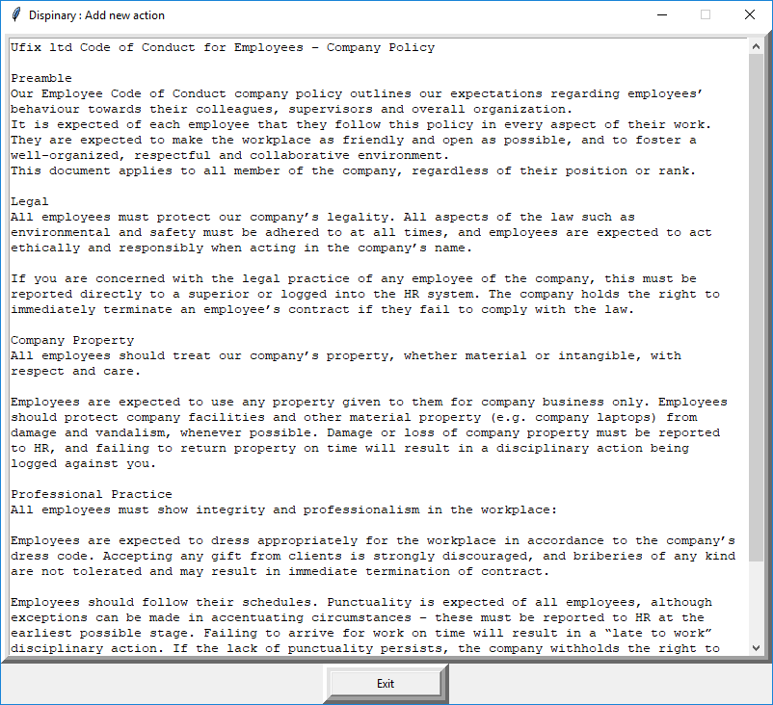
Program progress
Policy screen
Shows company Policy

Slide 4
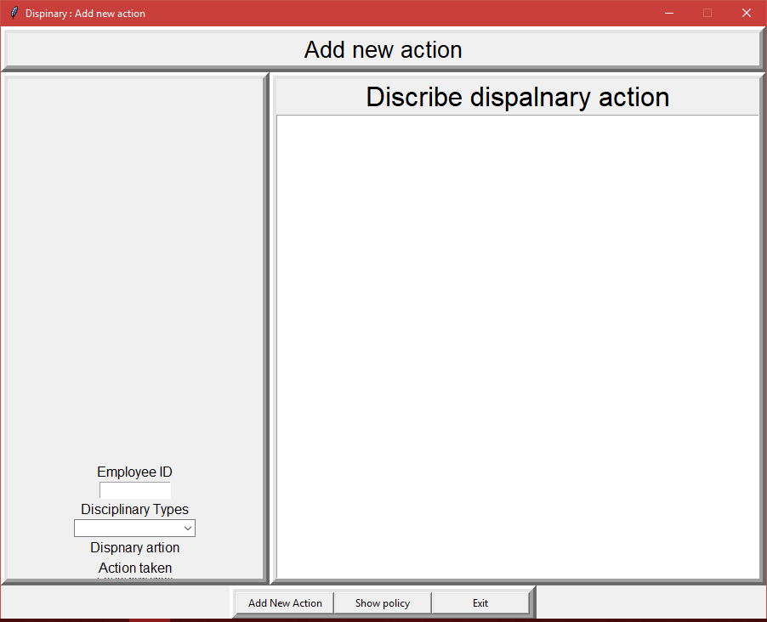
Program progress
Disciplinary action

Slide 5
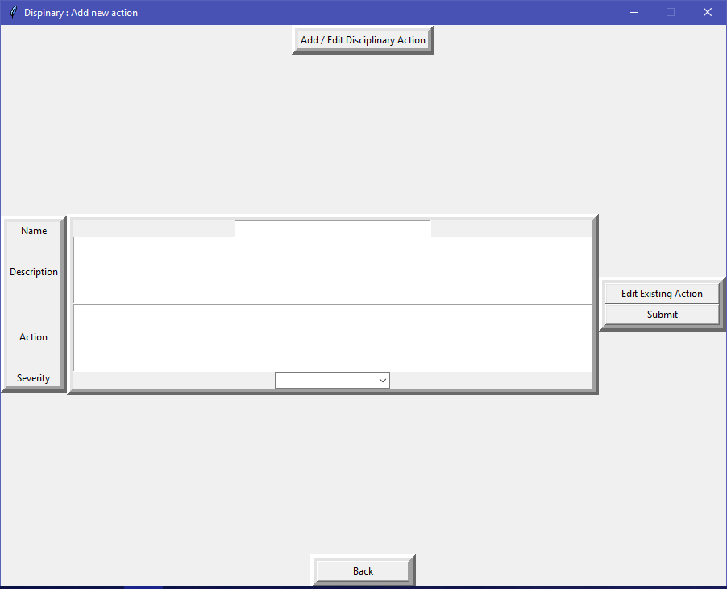
Program progress
Disciplinary action

Slide 6
Testing
Disciplinary action

